Slide 1



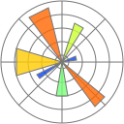
Programming with Python
Naufal Hanan Lutfianto¹
¹Telecomunication Engineering School of Electrical Engineering
Hp: 085786603992
E-mail: naufalhananl@telkomuniversity.ac.id
Presented at Thesis Writing Bootcamp (TWB-Camp) Thursday, 19 December 2024

Slide 2

Outline
What is python
Variable
Data Type
Data Structure
Operator
Conditional
Looping
Function
Introduction python numpy
Introduction python pandas
Introduction python matplotlib

Slide 3
What is Python
Python is an interpreted, object-oriented, high-level programming language with dynamic semantics.
Its high-level built in data structures, combined with dynamic typing and dynamic binding, make it very attractive for Rapid Application Development.
Python designed by Guido van Rossum in 1991 and developed by Python Software Foundation.
The two of the most used versions has to Python 2.x & 3.x.
* To take part this course, click this link

Slide 4


Variables (1/2)
Variable is a named placeholder to hold any type of data which the program can use to assign and modify during the course of execution.
In Python, there is no need to declare a variable explicitly by specifying whether the variable is an integer or a float or any other type.
The general format for assigning values to variables is as follows:
variable_name = expression
Variable name

Slide 5
Variables (2/2)
Follow the below-mentioned rules for creating legal variable names in Python.
Variable names can consist of any number of letters, underscores and digits.
Variable should not start with a number.
Python Keywords are not allowed as variable names.
Variable names are case-sensitive. For example, computer and Computer are different variables
Legal Variables Names | Illegal variable names
myvar = "John" | 2myvar = "John"
my_var = "John" | my-var = "John"
_my_var = "John" | my var = "John"
myVar = "John"
MYVAR = "John"
myvar2 = "John"

Slide 6
Data types (1/3)
Data types specify the type of data like numbers and characters to be stored and manipulated within a program. Basic data types of Python are
Numbers
Strings
Boolean
Data Types | Classes | Description
Numeric | int, float, complex | holds numeric values
String | str | holds sequence of characters
Boolean | bool | holds either True or False

Slide 7
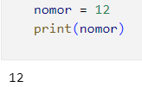

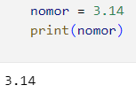

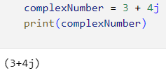

Data types (2/3)
An integer is a whole number with no decimal places. For example, 1 is an integer, but 1.0 isn’t. The name for the integer data type is int.
A floating-point number, or float for short, is a number with a decimal place. 1.0 is a floating-point number, as is -2.75. The name of the floating-point data type is float.
A complex number is represented as a pair of real numbers, where the first part is the real part and the second part is the imaginary part, followed by ‘j’ or ‘J’

Slide 8
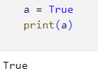

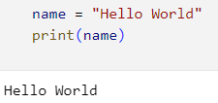

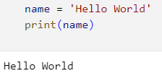
Data types (3/3)
Python boolean type is one of the built-in data types provided by Python, which represents one of the two values i.e. True or False. Generally, it is used to represent the truth values of the expressions.
Strings are one of the fundamental Python data types. The term data type refers to what kind of data a value represents. Strings are used to represent text.
Double Quotes
Single Quotes

Slide 9
Data Structures (1/10)
A data structure can be perceived simply to organize (store, process, retrieve) data in a computer programming or software with the purpose that they can be used effectively.
In Python, there are well-known data structure as given below.
List => a sequence of mutable data structure indexed by an integer number
Tuple => a sequence of immutable data structure indexed by an integer number
Set => similar to dictionary but it is mutable
Dictionary => Instead of number, it use “key” to point out data

Slide 10
Data Structures (2/10)
The list can be composed of many items or elements with any type of data.
Lists are constructed using square brackets [ ] wherein you can include a list of items separated by commas.
The anatomy of list.
Index
0
1
2
3
4
List name
List items
Opening bracket
Closing bracket

Slide 11
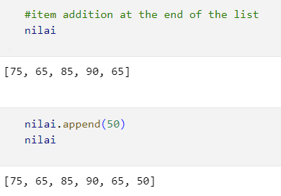
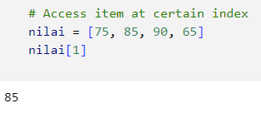
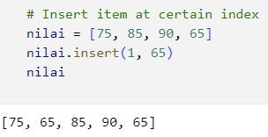
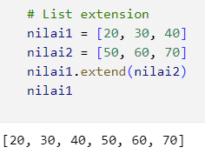
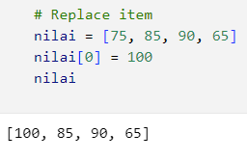
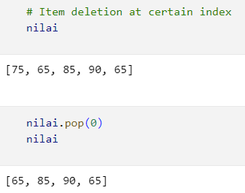
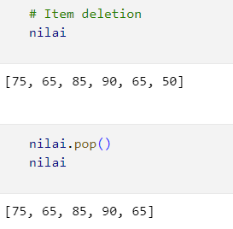
Data Structures (3/10)
The list can be manipulated as follows
Item addition / insertion
Item deletion
Item replacement
List extension

Slide 12
Data Structures (4/10)
A tuple is a finite ordered list of values of possibly different types which is used to bundle related values together without having to create a specific type to hold them.
Tuple have characteristics
Ordered - They maintain the order of elements.
Immutable - They cannot be changed after creation.
Allow duplicates - They can contain duplicate values.
The anatomy of tuple.
Index
0
1
2
3
Tuple name
Opening round bracket
Closing round bracket

Slide 13
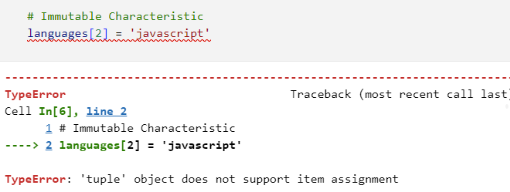
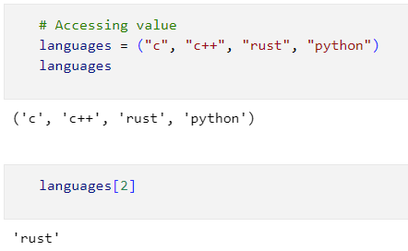
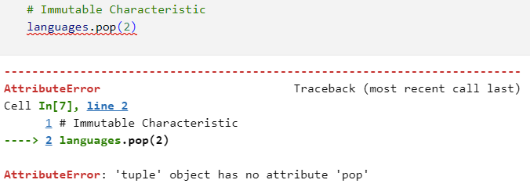
Data Structures (5/10)
What a tuple can do
Accessing value
Basic operation

Slide 14
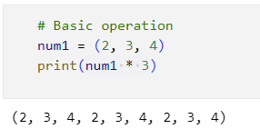
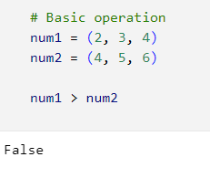
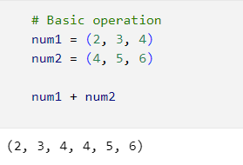
Data Structures (6/10)
What a tuple can do
Accessing value
Basic operation

Slide 15
Data Structures (7/10)
A set is an unordered collection with no duplicate elements. Basic uses include membership testing and eliminating duplicate entries.
The anatomy of set
Index
0
1
2
3
Set name
Opening curly bracket
Closing curly bracket

Slide 16
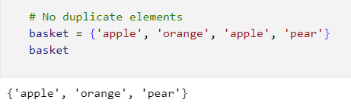
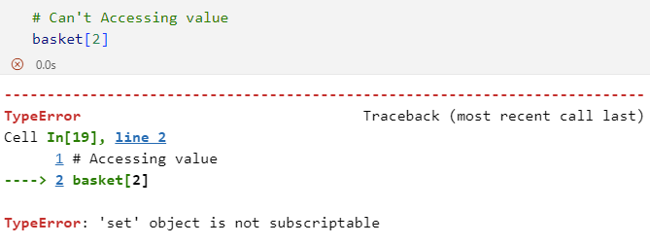
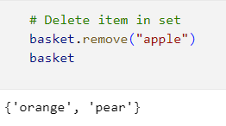
Data Structures (8/10)
What a set can do

Slide 17
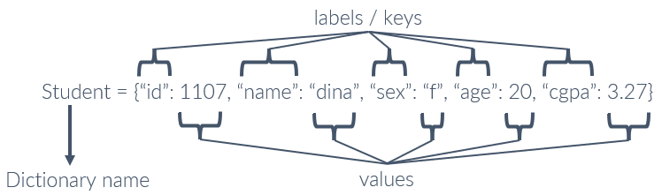
Data Structures (9/10)
Unlike the list, the dictionary organize its item based on its association.
As a result, the index of each item becomes less relevant in this kind of data structure because users will likely concern the association of the data toward their keyword or label.
The anatomy of dictionary

Slide 18
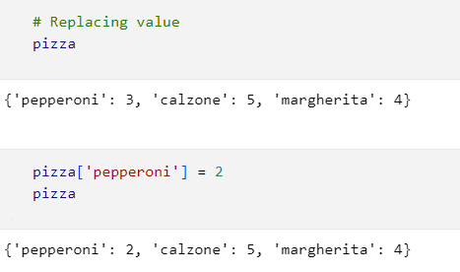
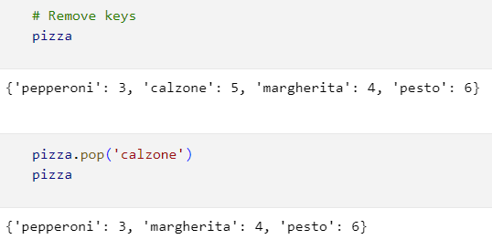
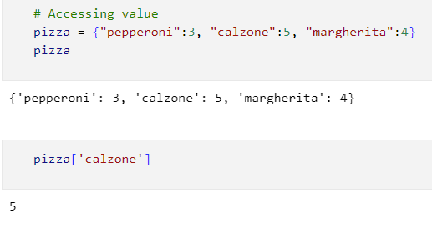
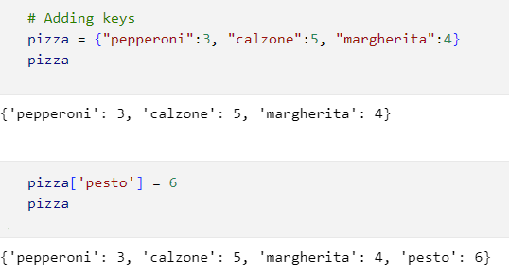
Data Structures (10/10)
The list can be manipulated as follows
Accessing values
Replacing values
Adding keys
Removing keys

Slide 19
Operator (1/5)
Operators are symbols, such as +, –, =, >, and <, that perform certain mathematical or logical operation to manipulate data values and produce a result based on some rules.
An operator manipulates the data values called operands.
Python language supports a wide range of operators. They are
1. Arithmetic Operators
2. Assignment Operators
3. Comparison Operators
4. Logical Operators
5. Bitwise Operators

Slide 20
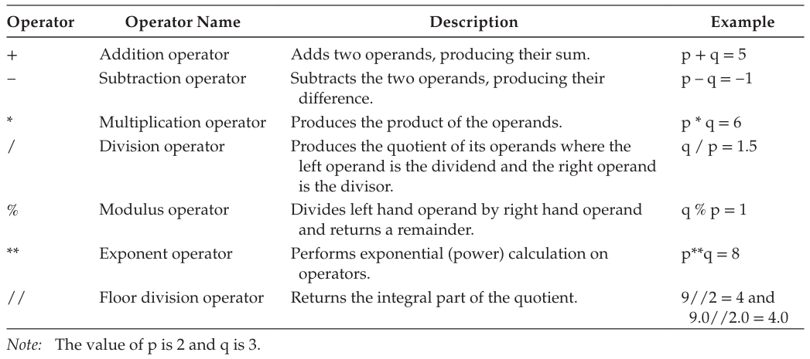
Operator (2/5)
Arithmetic operators are used to execute arithmetic operations such as addition, sub traction, division, multiplication etc.

Slide 21


Operator (3/5)
Assignment operators are used for assigning the values generated after evaluating the right operand to the left operand.
Assignment operators are either simple assignment operator or compound assignment operators.
Assignment operator
Assignment operator
Assignment shorthand notation

Slide 22
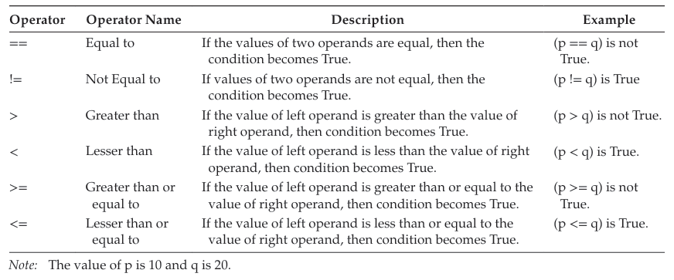
Operator (4/5)
When the values of two operands are to be compared then comparison operators are used.
The output of these comparison operators is always a Boolean value, either True or False.
The operands can be Numbers or Strings or Boolean values.

Slide 23
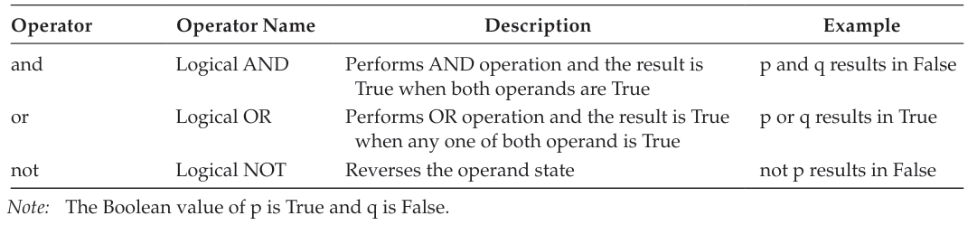
Operator (5/5)
The logical operators are used for comparing or negating the logical values of their operands and to return the resulting logical value.
The values of the operands on which the logical operators operate evaluate to either True or False.

Slide 24
Conditional Statements (1/4)
Conditional Statements are statements in Python that provide choices for control flow based on a condition.
The conditional statement checks to see if a statement is True or False.
In computer programming, the if statement is a conditional statement.
Types of Conditional Statements in Python
If conditional statement
If else conditional statement
If-elif-else conditional statement

Slide 25
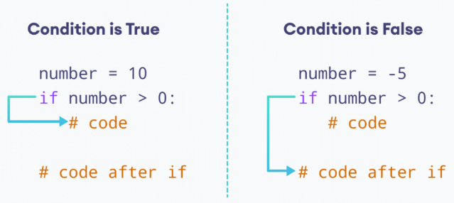
Conditional Statements (2/4)
Python if Statement
An if statement executes a block of code only when the specified condition is met.
The if statement decides whether to run some particular statement or not depending upon the value of the Boolean expression.

Slide 26
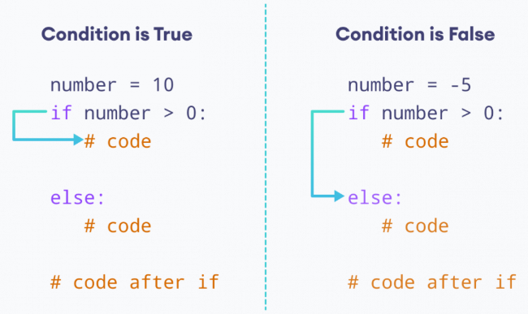
Conditional Statements (3/4)
Python if...else Statement
An if statement can also be followed by an else statement which is optional.
The if...else statement is used to execute a block of code among two alternatives.

Slide 27
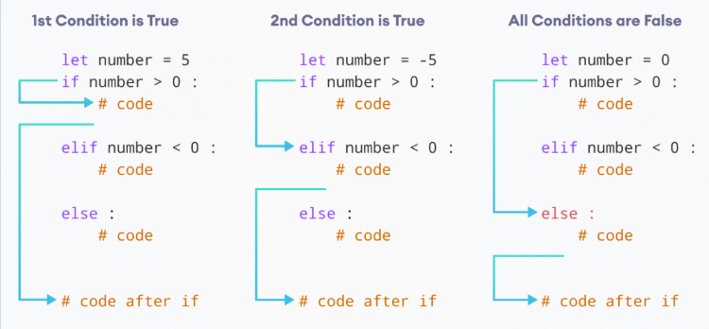
Conditional Statements (4/4)
Python if…elif…else Statement
The if…elif…else is also called as multi-way decision control statement.
Use to choose from several possible alternatives, then an elif statement is used along with an if statement.

Slide 28
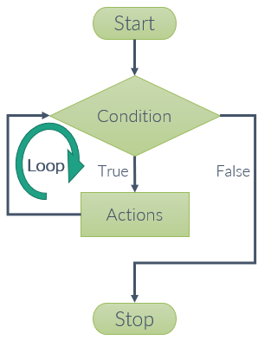
Looping (1/3)
A for loop is a programming construct that allows a block of code to be executed repeatedly until a certain condition is met.
Python programming language provides two types of looping For loop and While loop.

Slide 29
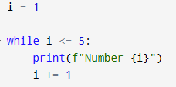


Looping (2/3)
a while loop is used to execute a block of statements repeatedly until a given condition is satisfied.
If the condition is True, body of while loop is executed. The condition is evaluated again.
This process continues until the condition is False.
Once the condition evaluates to False, the loop terminates.

Slide 30





Looping (3/3)
The for loop starts with for keyword and ends with a colon.
In Python, use a for loop to iterate over sequences such as lists, strings, dictionaries, etc.
iterator
iterable

Slide 31
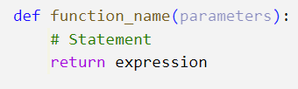
Function (1/2)
Python Functions is a block of statements that return the specific task.
The idea is to put some commonly or repeatedly done tasks together and make a function so that instead of writing the same code again and again for different inputs.
Some benefit of using functions
Increase code readability
Increase code reusability
keyword
function name
parameter
Body of statement
Function return

Slide 32
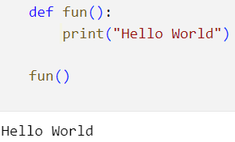
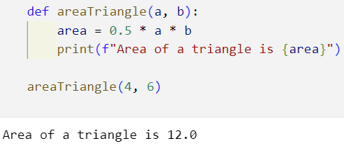
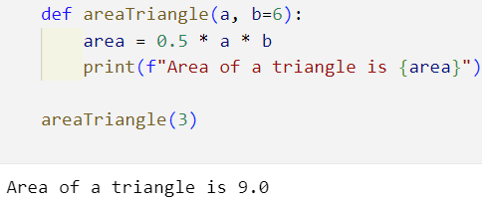
Function (2/2)
The def keyword introduces a function definition.
The term parameter or formal parameter is often used to refer to the variables as found in the function definition.

Slide 33
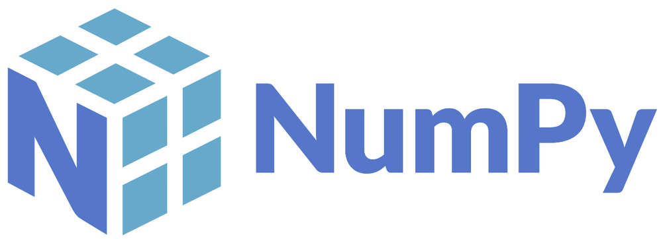
NumPy (1/3)
NumPy stands for ‘Numerical Python’. It is a package for data analysis and scientific computing with Python.
NumPy uses a multidimensional array object, and has functions and tools for working with these arrays.
NumPy can be easily interfaced with other Python packages and provides tools for integrating with other programming languages.

Slide 34
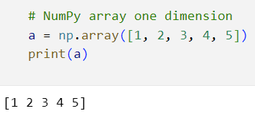
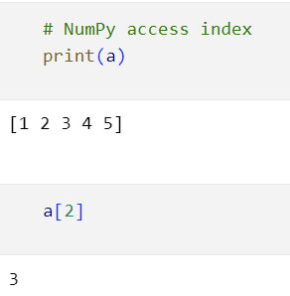
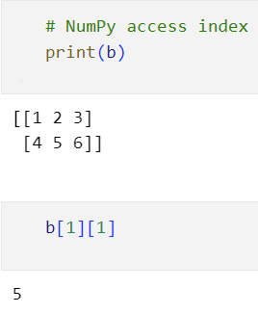
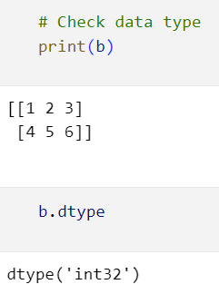
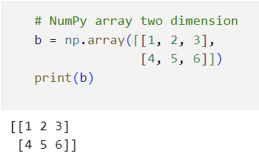
NumPy (2/3)
NumPy can be installed with conda or pip: pip install numpy
After installing NumPy, it may be imported into Python: import numpy as np

Slide 35
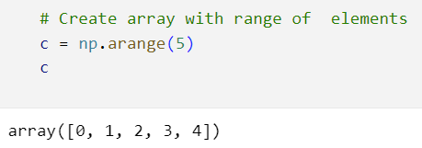
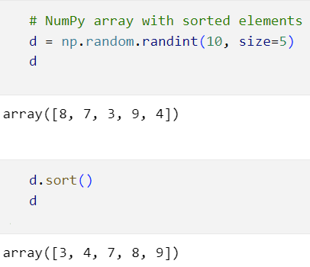
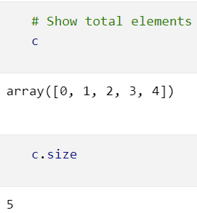
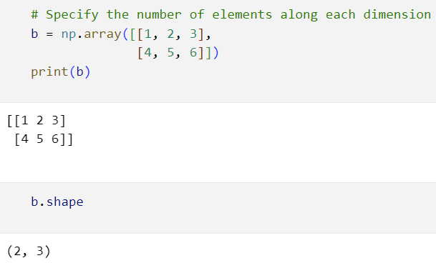
NumPy (3/3)
To create sequences of numbers, NumPy provides the arrange function.
Sorting an array is simple with np.sort()

Slide 36
Pandas (1/7)
Pandas is a fast, powerful, flexible and easy to use open source data analysis and manipulation tool, built on top of the Python programming language.
Pandas allows for importing and exporting tabular data in various formats, such as CSV or JSON files.
Pandas also allows for data cleaning features, including selecting a subset, creating derived columns, sorting, joining, filling, replacing, summary statistics, and plotting.

Slide 37



Pandas (2/7)
Pandas can be installed with conda or pip: pip install pandas
After installing Pandas, it may be imported into Python: import pandas as pd

Slide 38

Pandas (3/7)
Pandas I/O API is a set of top-level reader functions to read any format files like csv, excel, html, HDF5, etc.
Show data
Read csv file

Slide 39



Pandas (4/7)
DataFrame.info() prints information about a DataFrame including the index dtype and columns, non-null values and memory usage.
DataFrame.shape return a tuple representing the dimensionality of the DataFrame.
DataFrame.columns show the column labels of the DataFrame.

Slide 40


Pandas (5/7)
DataFrame.describe() generate descriptive statistics include those that summarize the central tendency, dispersion and shape of a dataset’s distribution, excluding NaN values.
DataFrame.isnull() detect missing values.

Slide 41


Pandas (6/7)
Pandas can use the logical operators on column values to filter rows.
In pandas it’s possible to filter more than one columns by combining multiple logical operator.

Slide 42


Pandas (7/7)
DataFrame.sort_values() used for sort by the values along either axis.
DataFrame.groupby() a groupby operation involves some combination of splitting the object, applying a function, and combining the results. This can be used to group large amounts of data and compute operations on these groups.

Slide 43

Matplotlib (1/8)
Matplotlib is a comprehensive library for creating static, animated, and interactive visualizations in Python.
Matplotlib makes easy things easy and hard things possible.
Key Features of Matplotlib:
Versatility
Customization
Integration with NumPy
Publication Quality:

Slide 44

Matplotlib (2/8)
Matplotlib can be installed with conda or pip: pip install matplotlib
Best practice to get started with matplotlib is import numpy and matplotlib: import numpy as np, import matplotlib.pyplot as plt.
Matplotlib.pyplot.scatter() A scatter plot of y vs. x with varying marker size and/or color.

Slide 45


Matplotlib (3/8)
matplotlib.pyplot.plot() is line chart used to represent the relation between two data X and Y on a different axis.

Slide 46


Matplotlib (4/8)
A bar plot uses rectangular bars to represent data categories.
matplotlib.pyplot.bar() the bars are positioned at x with the given alignment.
Their dimensions are given by height and width.

Slide 47


Matplotlib (5/8)
matplotlib.pyplot.pie() make a pie chart of array x.
A Pie Chart is a circular statistical plot that can display only one series of data.
The area of the chart is the total percentage of the given data.

Slide 48


Matplotlib (6/8)
A Box Plot is also known as whisker plot is created to display the summary of the set of data values.
matplotlib.pyplot.boxplot() the box extends from the first quartile (Q1) to the third quartile (Q3) of the data.

Slide 49


Matplotlib (7/8)
A histogram is a graph showing frequency distributions.
matplotlib.pyplot.hist() This method uses numpy.histogram to bin the data in x and count the number of values in each bin

Slide 50


Matplotlib (8/8)
Matplotlib styling

Slide 51
Reference
https://docs.python.org/3/
https://pandas.pydata.org/docs/
https://numpy.org/devdocs/
https://matplotlib.org/stable/users/explain/quick_start.html
V. Gowrishankar S., Introduction to Python Programming. Chapman and Hall/CRC Press, 2018.
All materials can be downloaded at this link

